Slide 1
Introduction of IT/Project oriented Training

Slide 2
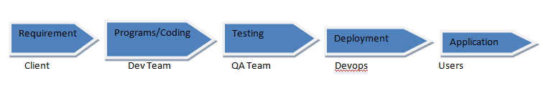
Hierarchy of a Software Company

Slide 3
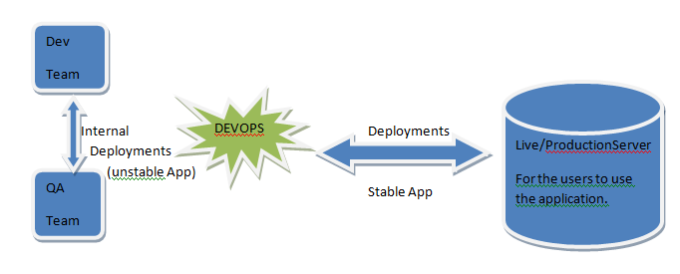
A software Company Overview
Every software company will work on the projects, Project like facebook/Whats up/Instagram/ Any Banking application.
Every project will have Servers and Data centre’s.

Slide 4
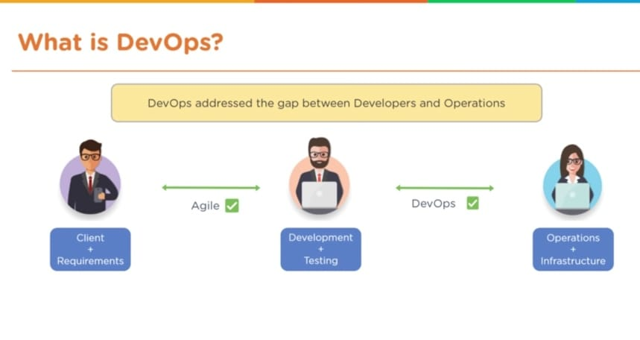

Slide 5
Deployment: if any new features is added into the existing application, then it is known as a Deployments.
So internal deployments carry out in the organization between the Dev and QA’s to make the application stable.
Once the application is stable it goes for a External deployments--→ Production/Live/Real Application.

Slide 6
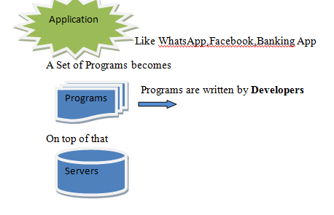
To build any Simple /Large Projects we need servers
Server: All the organizations will use linux servers.
Therefore Linux servers is the heart of any organization.

Slide 7
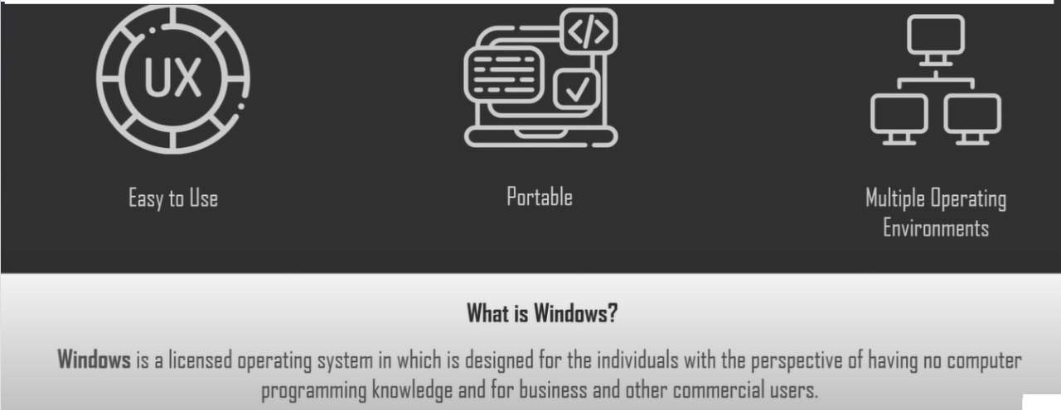

Slide 8
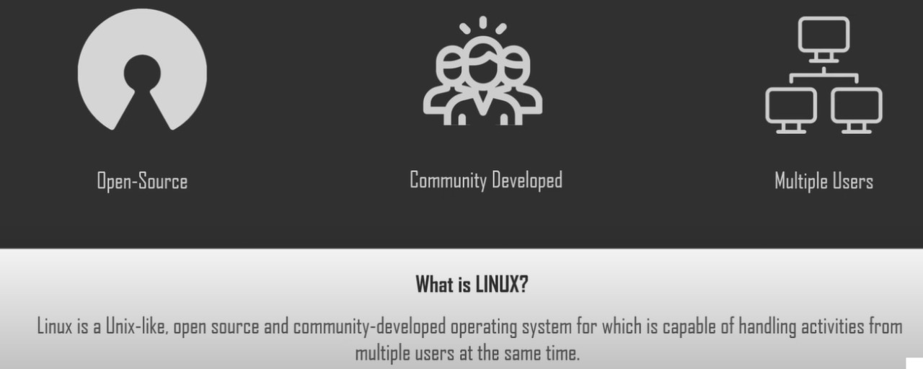

Slide 9
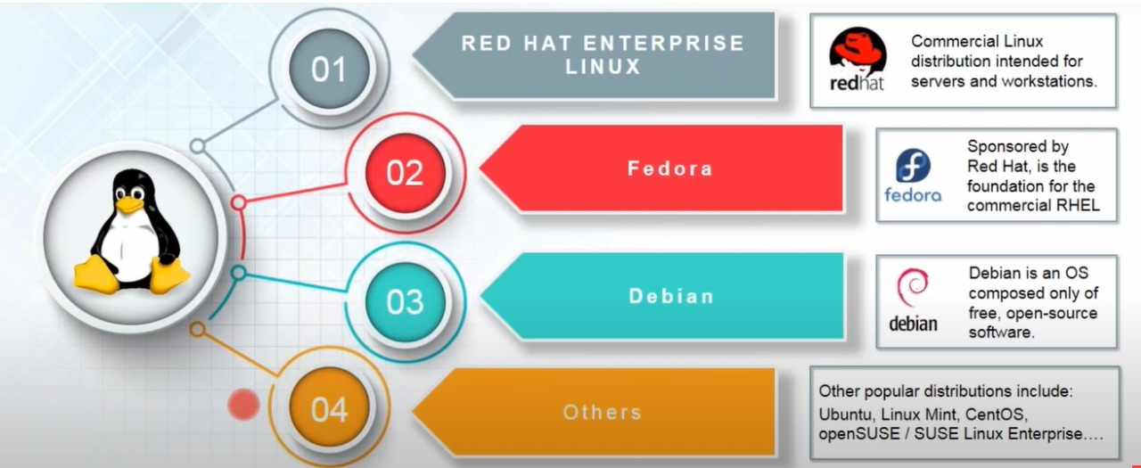

Slide 10
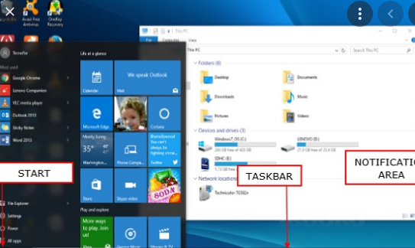
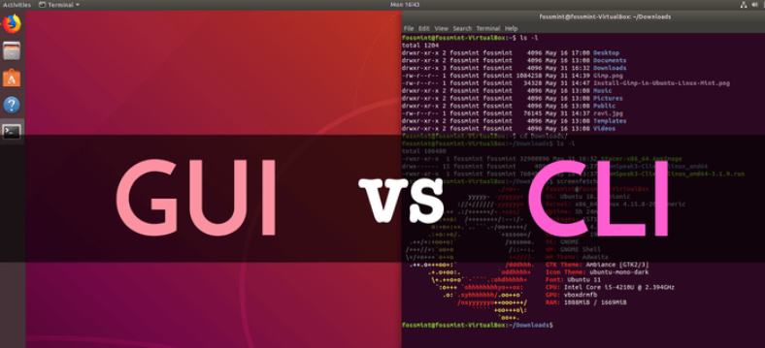
Windows Server: Operating S/M
Graphical user interface
Linux Server: Operating S/M
Command Line interface.

Slide 11
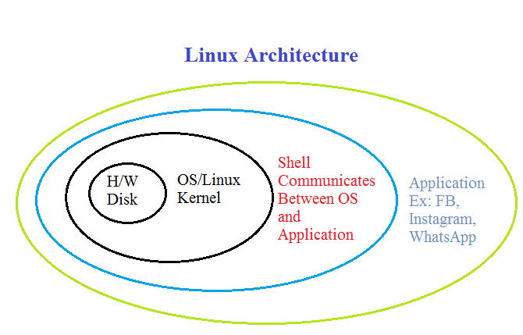

Slide 12
Features/advantages of Linux Servers:
Highly Secured.
Multiple Users / Remote Access.
Multi Tasking.
Hierarchical File System.
Virus Free.
Fast & Effective.

Slide 13
Linux Commands
Ls – List files and directories.
Files start with : –
Directories start with :d
Links start with : l
Ls –l : list files and directories with long format ( It will show in alphabetical)
Ls –lt :Long list format with time
Ls –lrt :reverse of ls –lt.
Ls –a : list the hidden files

Slide 14
Pwd : present working directory
Mkdir : creating a new directory
Cd : change directory
Cd .. : to come out of present directory
Cd ../../ : if you want to come out of 2 or more directories.
Cd /temp1/temp2/ -To move to the absolute path.

Slide 15
Cat – used to display the content of a file on console
Touch- used to create an empty file in linux.
Vi – used to edit a file on vi editor
Esc I – insert mode in vi editor.
Esc :wq! – save and quit the file.
W-write,q-quit,!-forcefully.
Esc :q! – quit without saving the content.
Esc :set number – which sets the number for a file.
Esc :set nonumber – used to remove the line numbers for a file.

